Slide 1
USER ACCESS MANAGEMENT IN CAR PROCESS
CURRENT PROCESS:
SEM Users :
  All CAR access rights in SEM are granted at the same time as Reporting /Planning accesses and have similar entity/maisons scope
Workflow Sharepoint Group:
  Only the requester list is maintained in Sharepoint by a functional admin
  A list of users is also maintained in the approval templates/matrix but is not necessary to get approval access (just to limit errors)
  Once a new reviewer/Approver is assigned, there is a routine which gives him automatically access to Sharepoint on any request where he has been assigned.
No link from SEM Access rights to Sharepoint.
Area for improvement:
Keep same functionality
Interface from SEM to Mendix to automatically create/update Local, Maison, Group requester roles
Manually providing right to create requests and see all requests
Providing automaticall right to see requests on which user is assigned
Notes:
Next step :
Check with Guiora /Sybille that granting SEM rights is acceptable
Check with Sebastian if any other special case to consider
Meeting with Yan, Daniele, Deloitte teams for simplifying the UAM and not from MyAccess (too simplistic info)

Slide 2
PROPOSED OPTION FOR UAM aUTOMATION
Objective :
Have a secured tool for this confidential process
Leverage SEM access (with an existing and audited access validation process) to automate the UAM in Mendix
SEM
My Access
Mendix
800 users :
SEggenberger : INPUT_CAR_ENT
Entity 51 – Brand ALL
Entity 334 – Brand ALL
Overnight creation of role
SEggenberger : INPUT_CAR_ENT
SEggenberger : INPUT_CAR_ENT
Overnight creation of restrictions
Entity 51 – Brand ALL
Entity 334 – Brand ALL
Automatic creation a review role
New user, not in SEM , only assigned to a review/approval in 1 specific CAR :
JSmith
Jsmith : REVIEW_CAR

Slide 3
EXAMPLE OF ROLES
SEM User | Mendix access
INPUT_CAR_ENT Entity 51 - Brand ALL Entity 334 - Brand ALL | Can create a local level request for Entity 51 and 334. Has by default a reviewer /approver role Can see any local request for Entity 51 and 334 performed by his colleagues
INPUT_CAR_BRD Entity ALL – Brand PIA | Can create maison level request for Piaget. Has by default a reviewer /approver role Can see any Maisonl request for PIAGET performed by his colleagues
INPUT_CAR_CDG Entity ALL – Brand ALL | Can create a group request for any Entity/Brand Has by default a reviewer /approver rôle Can see all the requests (with exception of M&A Car Types)
Not SEM User but assigned in a Mendix workflow | Can only see CARs he has been assigned to and perform review/Approve tasks.

Slide 4
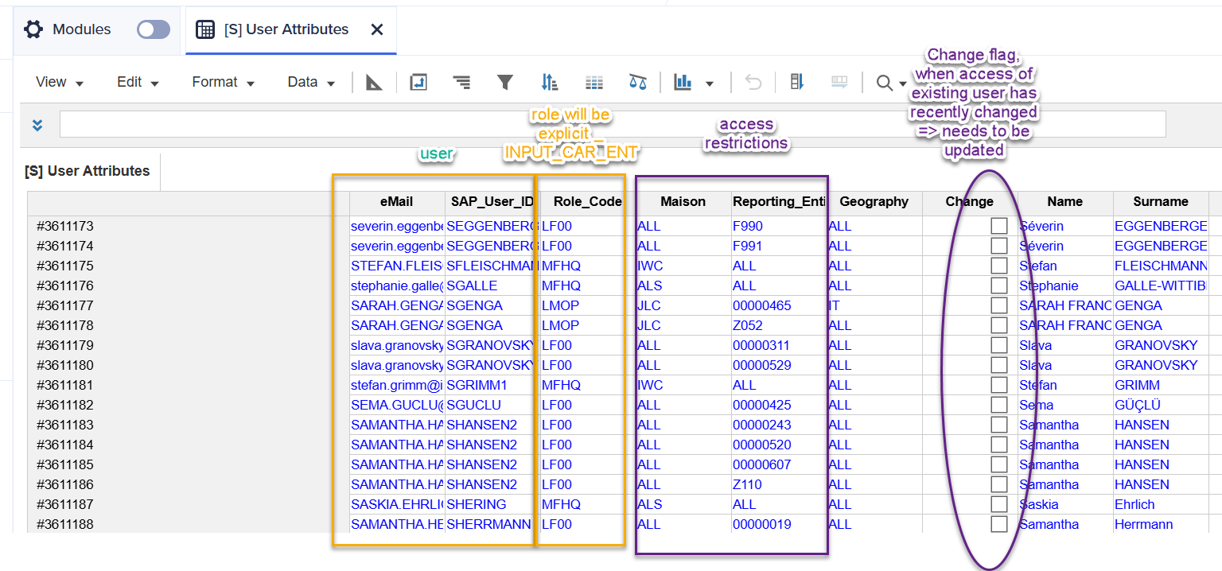
Example of table provided by sem every night

